Slide 1
DIVIDE AND CONQUER
by -
KARTIK SHAURYA (181210026)
HIMANSHU SRIVASTAVA (181220031) - last roll no.

Slide 2
Definition
Recursion lends itself to a general problem-solving technique (algorithm design) called divide & conquer
Divide the problem into 1 or more similar sub-problems
Conquer each sub-problem, usually using a recursive call
Combine the results from each sub-problem to form a solution to the original problem
Algorithmic Pattern:
DC( problem )
solution = ∅
if ( problem is small enough )
solution = problem.solve()
else
children = problem.divide()
for each c in children
solution = solution + c.solve()
return solution
Divide
Conquer
Combine

Slide 3
Applicability
Use the divide-and-conquer algorithmic pattern when ALL of the following are true:
The problem lends itself to division into sub-problems of the same type
The sub-problems are relatively independent of one another (ie, no overlap in effort)
An acceptable solution to the problem can be constructed from acceptable solutions to sub-problems

Slide 4
PROBLEM STATEMENT
Given many stacks of coins which are arranged adjacently.
We need to collect all these coins in the minimum number of steps.
In one step we can collect one horizontal line of coins or vertical line of coins and collected coins should be continuous.

Slide 5
EXAMPLE
Input : height[] = [2 1 2 5 1]
Each value of this array corresponds to the height of stack that is we are given five stack of coins, where in first stack 2 coins are there then in second stack 1 coin is there and so on.

Slide 6
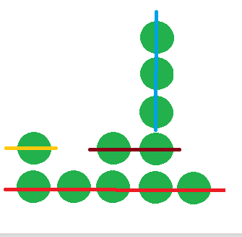
SOLUTION

Slide 7
SOLUTION
First, we have collected last horizontal line of coins after which stacks remains as [1 0 1 4 0] after that, another horizontal line of coins is collected from stack 3 and 4 then a vertical line from stack 4 and at the end a horizontal line from stack 1. Total steps are 4.

Slide 8
Let us solve this problem using DIVIDE AND CONQUER method.

Slide 9
SOLUTION APPROACH
We can see that it is always beneficial to remove horizontal lines from below.
Suppose we are working on stacks from l index to r index in a recursion step, each time we will choose minimum height, remove those many horizontal lines after which stack will be broken ( DIVIDE ) into two parts, l to minimum and minimum +1 till r and we will call recursively in those sub arrays.

Slide 10
SOLUTION APPROACH
Another thing is, we can also collect coins using vertical lines.
So,we will choose minimum between the result of recursive calls and (r – l) because using (r – l) vertical lines we can always collect all coins.

Slide 11
TIME COMPLEXITY
Each time we are calling each sub array and finding minimum.
Total time complexity of the solution will be O(n²).

